Slide 1

MCA Major Project Mid Term Evaluation
UPI Spam Detection Using Machine Learning
Under the guidance of
Dr. Vaibhav Bhatnagar
Department of Computer Applications
Faculty of Science, Technology and Architecture
Manipal University Jaipur
By
Student Name
Reg No.23FS20MCA00067
2023-25

Slide 2
Outline
Introduction
Motivation
Process Model
Data Flow Diagram (DFD)
Output
Conclusion
Future Scope

Slide 3
Introduction
This project focuses on developing a robust model for detecting fraudulent transactions within the Unified Payments Interface (UPI) system. UPI, a popular real-time mobile payment system in India, has witnessed a surge in usage, making it crucial to implement effective fraud detection mechanisms.
This project leverages a dataset containing transaction details, including payment gateways, transaction types, locations, device information, and merchant categories, to identify patterns indicative of fraudulent activities. The analysis involves exploring various features, visualizing transaction trends, and employing machine learning algorithms to build a predictive model.

Slide 4
Motivation
Combating Fraud
UPI spam can be a precursor to fraudulent activities.
Protecting users from financial loss is paramount.
Enhancing User Experience
Reducing spam improves the overall UPI experience.
Users can focus on legitimate transactions.
Maintaining System Integrity
Spam can overload the UPI system, impacting performance.
Detection helps maintain a stable environment.

Slide 5
Process Model
Data Collection
Gathering transaction data from UPI systems.
Data Preprocessing
Cleaning and formatting data for analysis.
Model Training
Training a machine learning model with labeled data.
Model Evaluation
Evaluating the model's performance and accuracy.
Deployment
Deploying the model to detect spam in real-time.

Slide 6
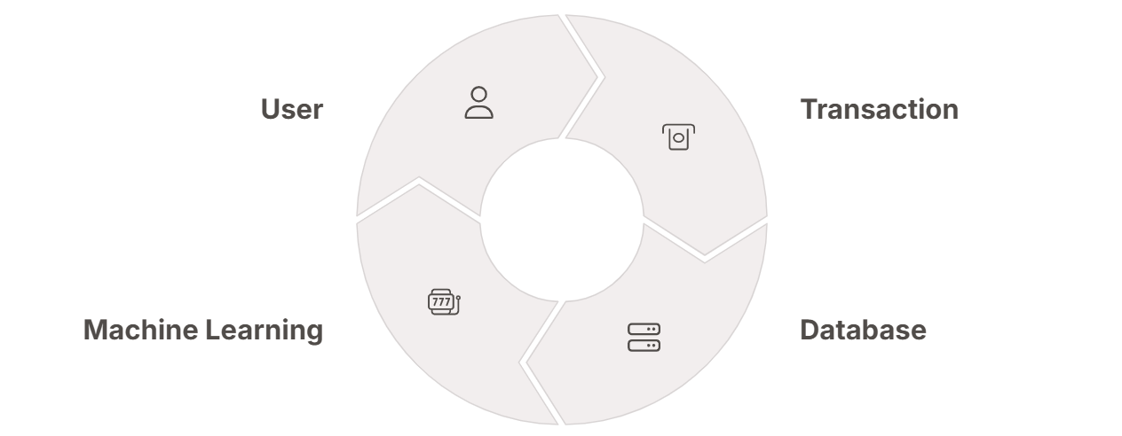
Data Flow Diagram (DFD)
Data flows from user transactions to a database. The machine learning model analyzes the data. This process identifies and flags potential spam transactions.

Slide 7
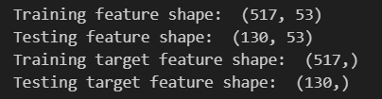
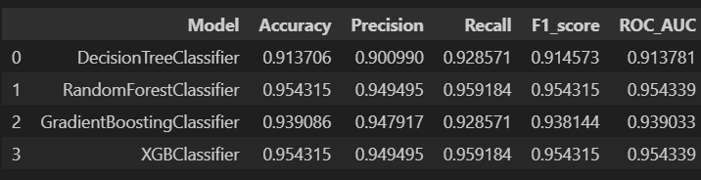
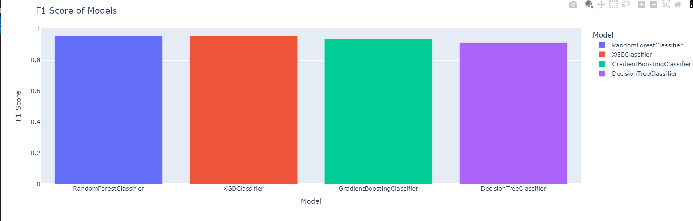
Output

Slide 8
Conclusion
Effective Detection
Machine learning models can effectively detect UPI spam.
Improved Security
Spam detection enhances overall UPI security.
Better User Experience
Users benefit from a cleaner, safer transaction environment.

Slide 9
Future Scope
Expanding Spam Detection Capabilities
Mobile Integration
Directly integrate spam detection into UPI apps.
Advanced Algorithms
Employ deep learning for enhanced accuracy.
Global Models
Adapt models to detect spam across diverse regions.

